Slide 1

15 September 2022
LOAN RISK CAPSTONE
TEAM 4
Wan Ahmed Izzat Daniel Bin Wan Khalid
Muhammad Fakhrul Ammar Bin Md Desa

Slide 2

AGENDA
1
3
TOP 3 FACTORS THAT CONTRIBUTE TO LOAN DEFAULT CASES
TOP 3 FACTORS THAT DETERMINE LOAN APPROVAL
LESSON LEARNT
2
Notes:
Introduction
Today we are going to share our findings on loan risk dataset to our RHB management.
We are able to identify the Top 3 criteria that determine the success or reject of loan applicants.
And also identify our top 3 factors that contribute to loan default cases.
So, we decided to use comparison method of storytelling hence why most of visualization are in bar charts.

Slide 3

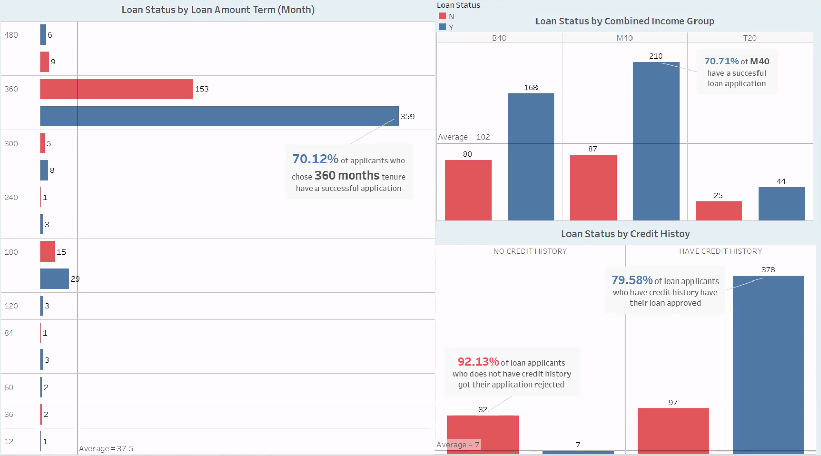
CREDIT HISTORY, LOAN TERM, AND COMBINED INCOME ARE THE TOP 3 FACTORS IN LOAN APPLICATION. IT SHOWS A DIFFERENCE TO YES AND NO OF LOAN STATUS COMPARED TO OTHER FACTORS. PLEASE PRIORITIZE THESE FACTORS WHEN APPROVING A LOAN APPLICATION
Notes:
Based On Our Findings, CREDIT HISTORY, LOAN TERM, AND COMBINED INCOME ARE THE TOP 3 FACTORS IN LOAN APPLICATION. Please Prioritize These Factors When Approving A Loan Application
As you can see in the left chart, the loan status by loan amount term (baca annotation dekat chart).
Note that, 85% of total loan applicants choose 30 years of loan tenure.
Next on upper right chart, the loan status by combined income group. For this factor, we group the all the combine income based on Malaysia group income which are B40(RM1-RM4849), M40(RM4850-RM10,959) and T20(RM10,960 and above)
We found that, (baca annotation dekat chart). Please note that, 48% of total loan applicant are M40.
The last factor is Loan status by credit history.
(Baca annotation biru).
However, (baca annotation merah)
Moving to the next slide,

Slide 4
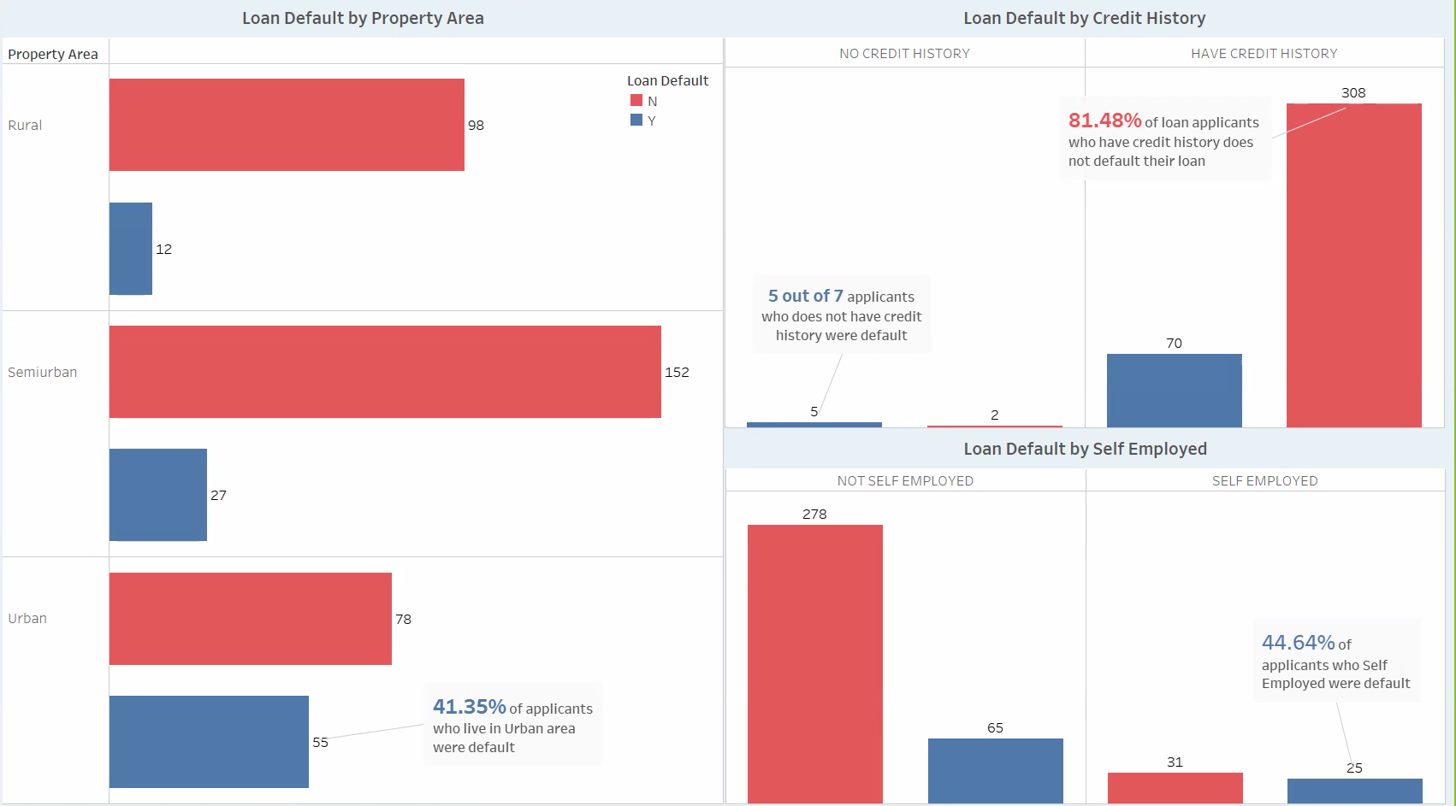
PROPERTY AREA, CREDIT HISTORY AND SELF EMPLOYED ARE THE TOP FACTORS THAT CONTRIBUTED TO THE HIGH NUMBER OF LOAN DEFAULT. IT SHOWS A DIFFERENCE TO YES AND NO OF LOAN DEFAULT COMPARED TO OTHER FACTORS. PLEASE FOCUS THESE FACTORS TO REDUCE THE LOAN DEFAULT CASES
Notes:
Moving to the next slide, based on our analysis, PROPERTY AREA, CREDIT HISTORY AND SELF EMPLOYED ARE THE TOP FACTORS THAT CONTRIBUTED TO THE HIGH NUMBER OF LOAN DEFAULT. PLEASE FOCUS THESE FACTORS TO REDUCE THE LOAN DEFAULT CASES
On the left chart, the loan default by property area, (baca annotation).
We assume that this is due to high cost of living in the urban area.
Next on the top right, loan default by credit history.
(Baca annotation biru). Although it is a small figure, we decided that we need to take it seriously to prevent the numbers from going up.
In addition, (baca annotation merah), but we can further reduce the amount of default by adding extra filtering on applicants' credit history.
The last factor that contribute to the loan default is by self employed.
(Baca annotation biru)
In conclusion, the top 3 factors for successful loan application are CREDIT HISTORY, LOAN TERM, AND COMBINED INCOME .
Meanwhile, the top 3 factors for loan default are PROPERTY AREA, CREDIT HISTORY AND SELF EMPLOYED .

Slide 5
WHAT WE LEARNT AND HOW ITS AN ADVANTAGE TO US
We learnt excel analytics especially pivot table, formulas, descriptive statistics
We learnt Data Visualization using Tableau by creating charts and dashboard and utilizing the given tools.
We learnt Data Storytelling especially on how to present, how to choose suitable chart and font and create story based on dataset given.
In Capstone, we learnt how to apply the knowledge given to complete the project from scratch independently.
Futureproof our career by improving our data literacy and analytic skill.

Slide 6
Thank you.

